Slide 1
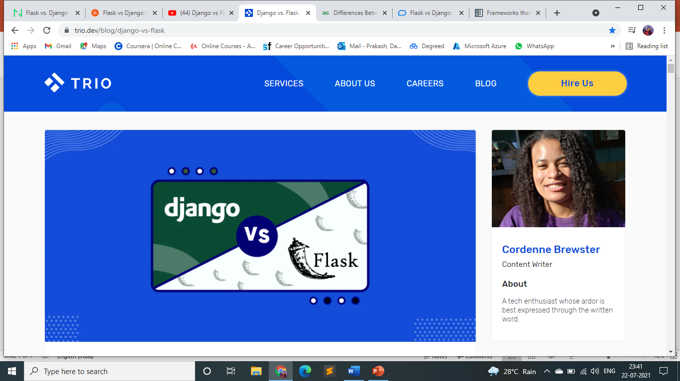
BY- DAMINI PRAKASH
(EMP ID: 46071522)

Slide 2
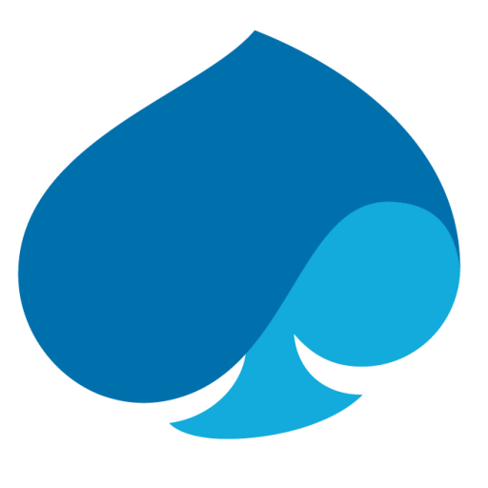
A brief overview on DJANGO and FLASK
Django is a Python full-stack framework for web development. This framework stands out for its "batteries included" system approach, meaning that it provides the most typically required libraries and tools.
This versatile framework was launched in 2005 and developed by Adrian Holovaty and Simon Willison. Django helps developers to build and maintain web applications' quality.
Flask is a Python microframework for web development. Despite being built with a small core and considered a very lightweight Web Server Gateway Interface (WSGI), Flask stands out for its easy-to-extend philosophy.
Flask was developed by Armin Ronacher and introduced in 2010 on April Fool's day. It was designed to scale up to complex applications and to support an easy and quick start.

Slide 3
Django vs Flask
Features | Flask | Django
Type | Lightweight microframework. | Full-stack framework.
Template Engine | Flask is based on the Jinja2 format motor. | Built-in template engine.
Admin | Does not have a feature to manage administration tasks, but it does have an extension: Flask-Admin. | Django already comes with an admin panel
Database | Has many libraries (e.g., SQLAlchemy, PyMongo, and PonyORM) and extensions (e.g., Flask-Peewee, Flask-Pony, and Flask-Alembic) available. | Built-in ORM, that enables developers to work with several relational database systems.
Development | Provides more control over the components the developer wishes to implement. | Since it integrates all the "batteries", developers have the required tools at their disposal for quick implementation.
Flexibility | High flexibility - Flask enables developers to build and add functionalities to simple applications in a flexible way. | Low flexibility - Developers are not as free to use other plugins and libraries as they are with Flask.
Learn | Easier to learn. | High learning curve.

Slide 4
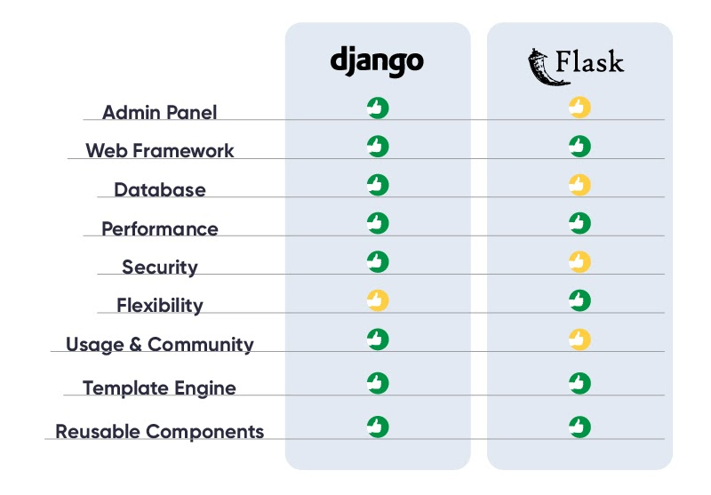
Why should we choose django over flask

Slide 5
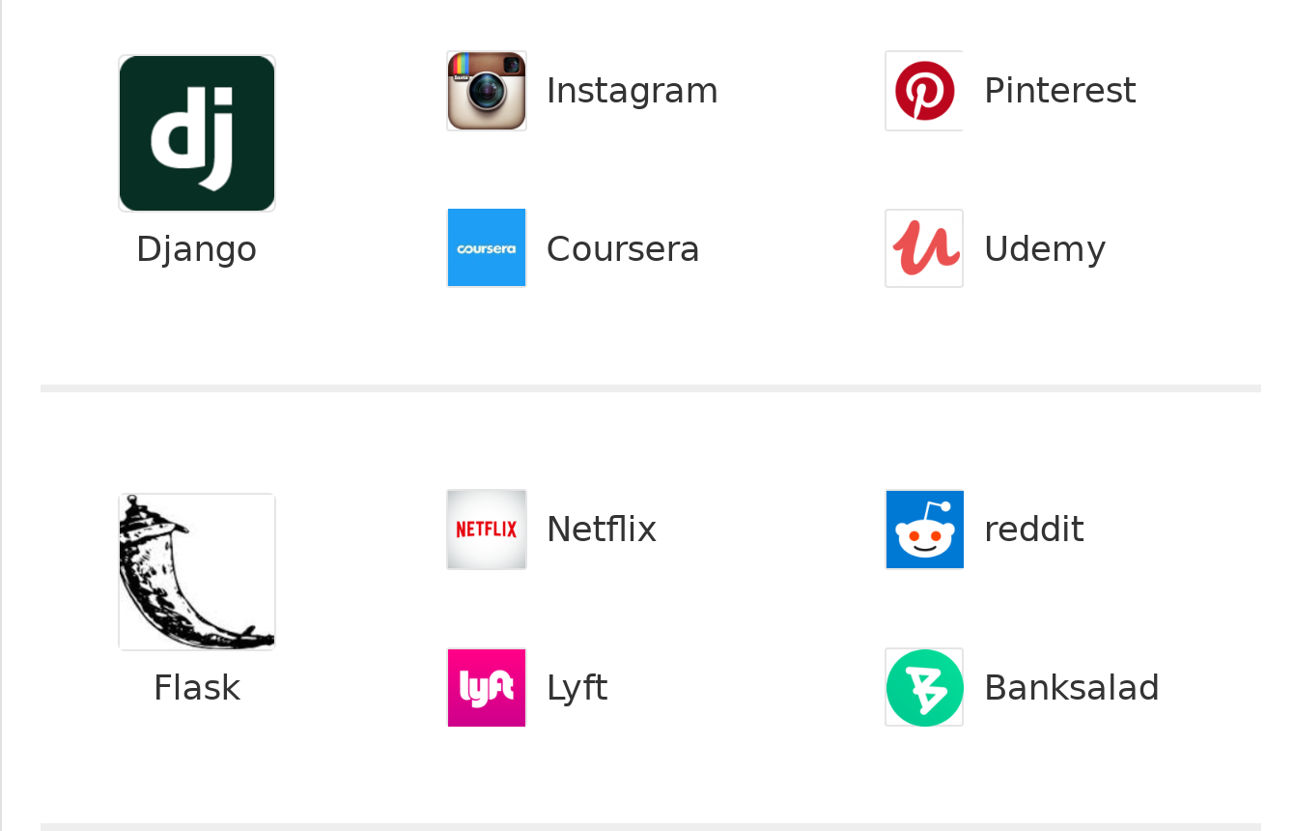
Famous companies using Django and flask

Slide 6
Conclusion
Django and Flask are two sides of the same coin, and yet they face comparison regularly.
When comparing Flask and Django, the aim is not to declare that one framework is better than the other. Rather, it is to examine the key points that will enable you to make an informed decision, against the needs of your individual project.
The main thing to remember when choosing a framework, is that they are not a one-size-fits-all solution; the individual project needs should take precedence. Consider the size of the app you wish to build plus plans for future growth, how much customisation will be required, and the type of app you are building.

Slide 7
References
https://www.geeksforgeeks.org/
https://www.imaginarycloud.com/
https://trio.dev/blog/
https://www.mindfiresolutions.com/blog/2018/05/flask-vs-Django/

Slide 8


